Slide 1
Personal E-notes Management
A Mini Project Presentation to Chaitanya Deemed to be University in partial fulfillment of minimum academic requirements for
BACHELOR OF TECHNOLOGY IN
COMPUTER SCIENCE AND ENGINEERING 3rd year 2nd semester.
TEAM MEMBERS
UPENDAR THOTA(221202076)
CHANDU PODILA(221202079)
RAJINIKANTH MALLELA(221202083)
SAINIKHIL MARKA(221202109)
UNDER THE GUIDANCE OF
Mr. V.SRUJAN (Asst. Professor)

Slide 2
Abstract
Our project aims to transform digital note-taking by introducing a user-friendly web application for creating, editing, and organizing electronic notes (E-Notes). Key features include an advanced text editor, robust organizational tools, and stringent security measures for user privacy. With responsive design, our platform ensures seamless usage across devices, enhancing personal organization, productivity, and the overall digital experience.

Slide 3
Introduction
The Personal E-Notes Management project aims to provide a versatile and secure platform for managing electronic notes.
The Personal E-notes Management Project is aimed at creating a user-friendly platform for individuals to organize, store, and access their electronic notes efficiently.

Slide 4
System Requirements
Software Requirements
Operating system :Windows 11
IDE : Eclipse
Frontend : HTML , CSS , BOOTSTRAP.
Backend : JSP(Java Server Pages)
Database : Mysql
Application server : Apache Tomcat
Hardware Requirements
PROCESSOR 10TH GEN INTEL CORETM I5-1135G7 @ 2.40 HZ 2.42HZ
RAM:8.00GB RAM

Slide 5
Existing System
Personal E-Notes Management Systems have a variety of tools and platforms to cater to users' note-taking and organization needs.
The existing system includes categories such as standalone Note-taking Apps, Document Management Systems, and Productivity Platforms like Microsoft Office 365, Google Workspace, and Notion.
Standalone Note-Taking Apps like Ever note, OneNote, and Google Keep offer users the ability to create and organize digital notes in various formats, but may lack collaboration features and integrations with other productivity tools.

Slide 6
Proposed system
Personal E-Notes Management is a digital platform designed to revolutionize personal note-taking and organization.
The system offers a user-friendly interface, advanced formatting options, and organization tools such as tags and search functionality to streamline the process.
Security and privacy are top priorities, with encryption protocols, secure authentication mechanisms, and access controls to protect personal information and sensitive data.
The system aims to empower users to take control of their digital lives and enhance productivity and efficiency.

Slide 7
Features and Functionalities
The Personal E-notes Management Project is aimed at creating a user-friendly platform for individuals to organize, store, and access their electronic notes efficiently.

Slide 8

Project Goals and Objectives
Enhance User Experience
Improve Accessibility
Create an intuitive interface for easy navigation and efficient task management.
Ensure that the platform is accessible to users with diverse needs and preferences.
Scalability & Flexibility
Data Security
Design a system that can accommodate growth and adapt to changing requirements.
Implement robust security measures to protect user data and maintain privacy.

Slide 9
Methodology
1.Requirement Analysis :​
Notes should quickly and simply summarize important information and thoughts.
Notes should be organized as logically as possible.
Notes should be quickly and easily accessible at any time and from any place.
2.System Design :​
Designed a database schema for efficient storage and retrieval of notes and user information.​
Created a user-friendly home page and all functionalities.​
Defined system architecture including server setup, database integration, and front-end development tools.​
3.Implementation :​
Developed the system using HTML, CSS, Bootstrap for the front-end.​
Implemented java , jsp for backend and MySQL for database .​​

Slide 10
4.Testing : ​
Conducted unit testing, integration testing, and user acceptance testing (UAT) to ensure system functionality.​
Addressed bugs and usability issues identified during testing phase.​
​
5.Deployment and maintenance :​
Deployed the system on a apache tomcat server with necessary configurations.​
Implemented regular maintenance tasks such as backups, security updates, and performance optimization.​
Monitored system performance.

Slide 11
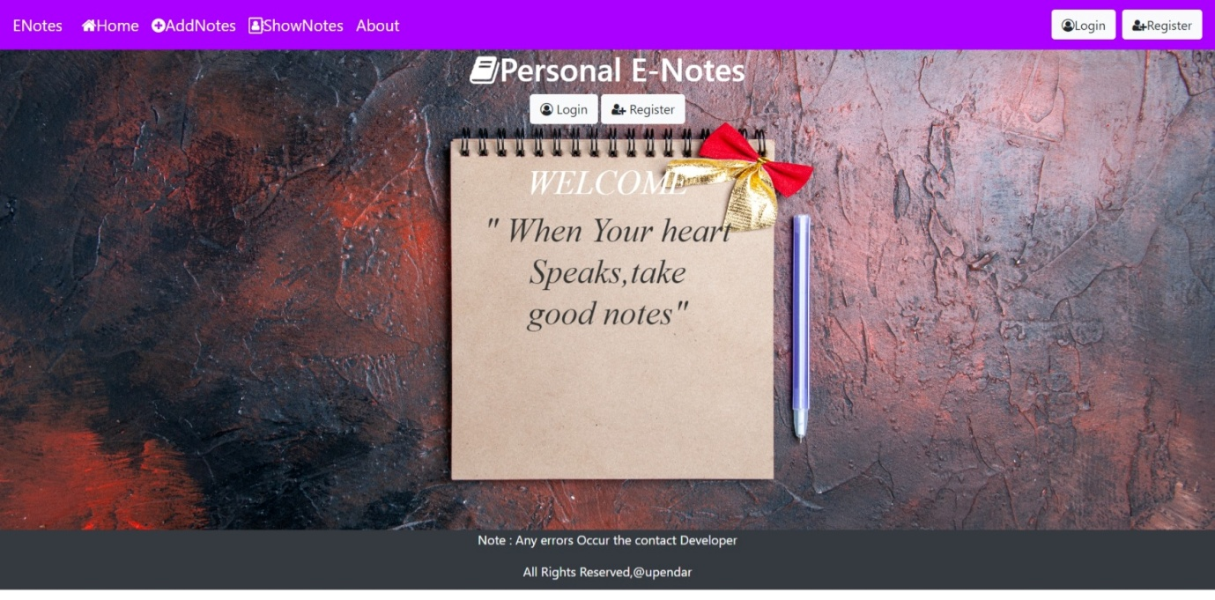
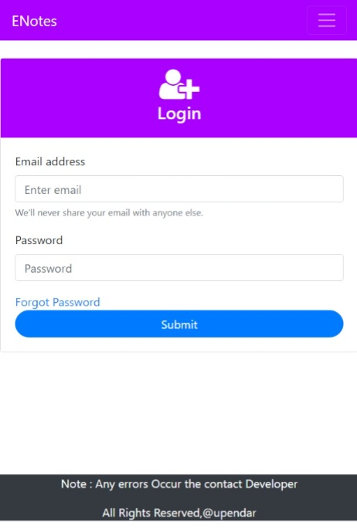
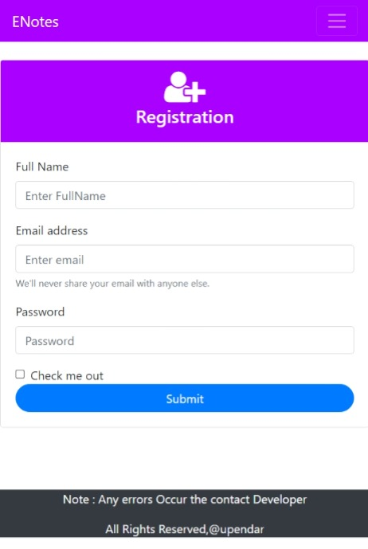
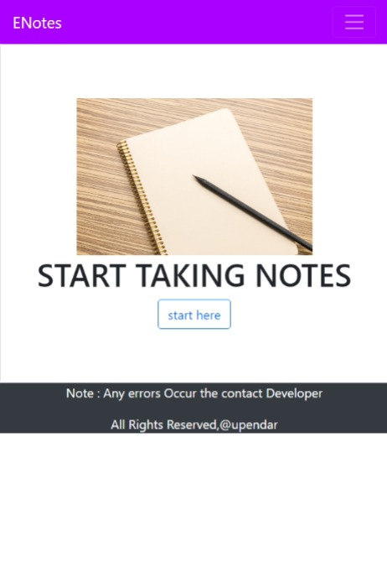
Results

Slide 12
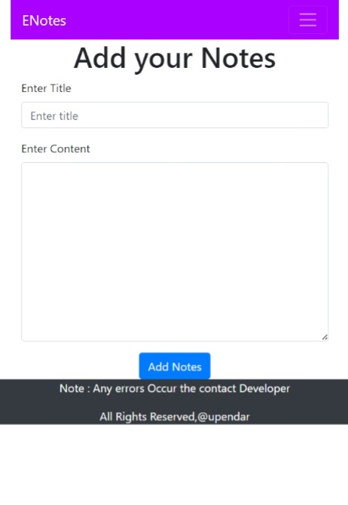
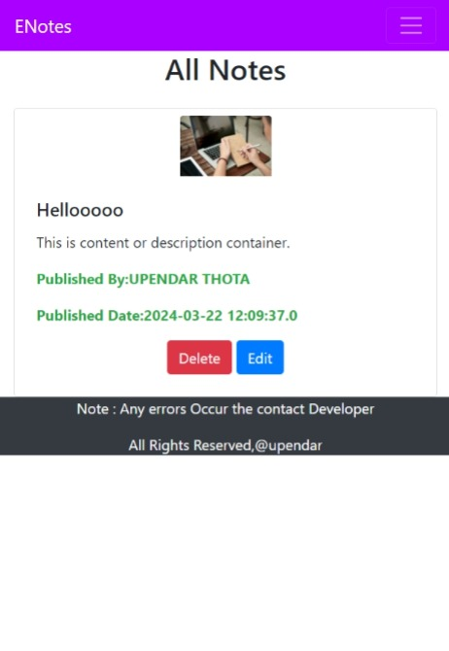
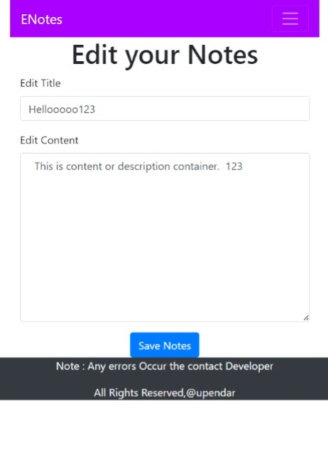
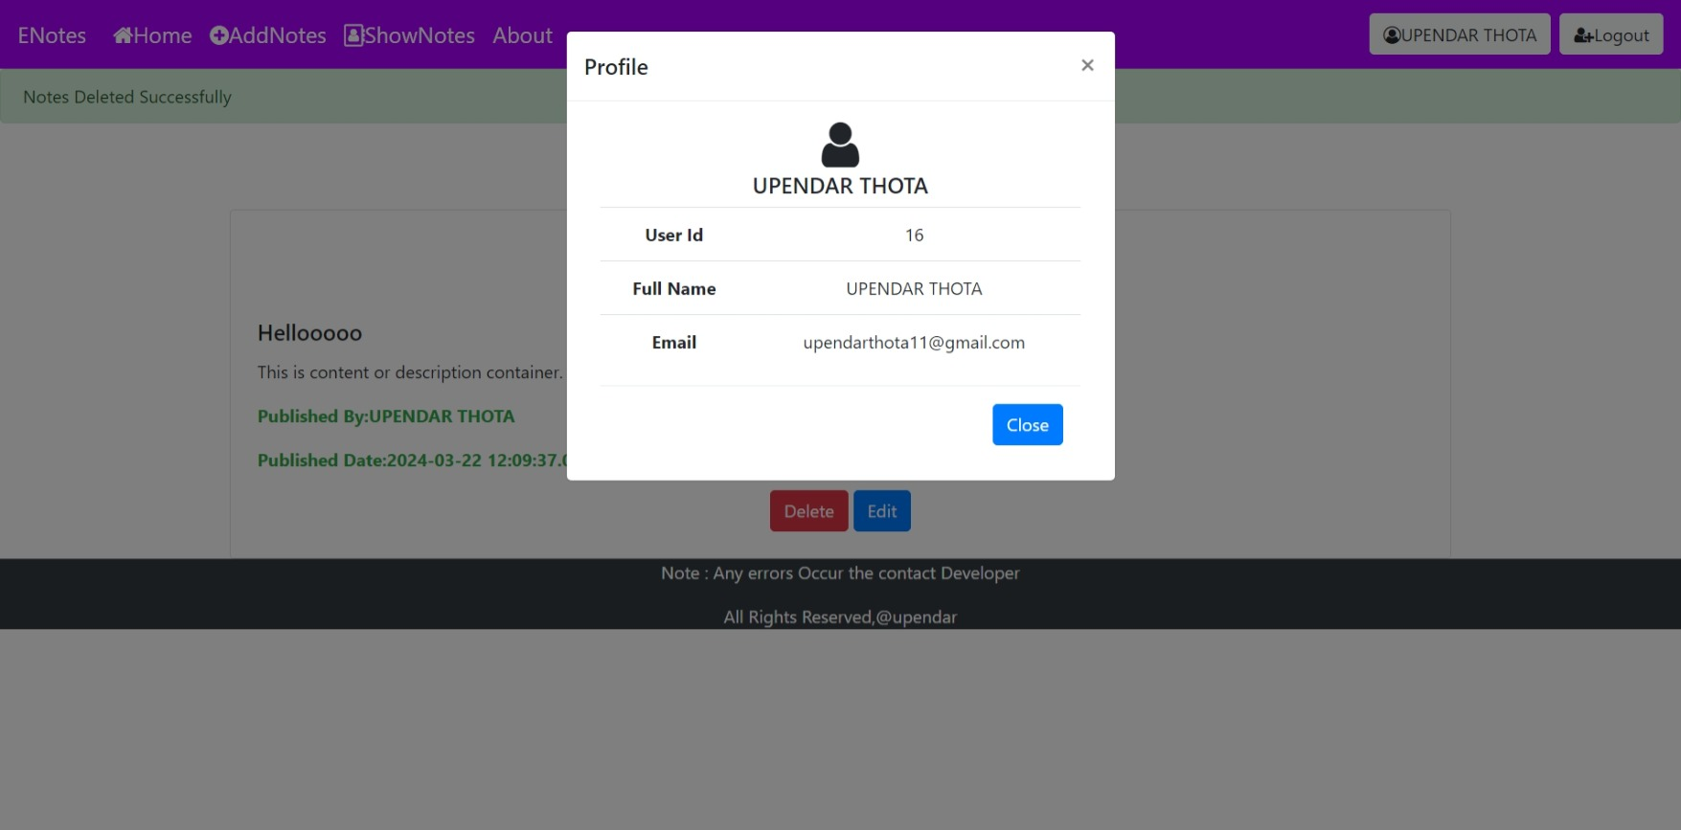
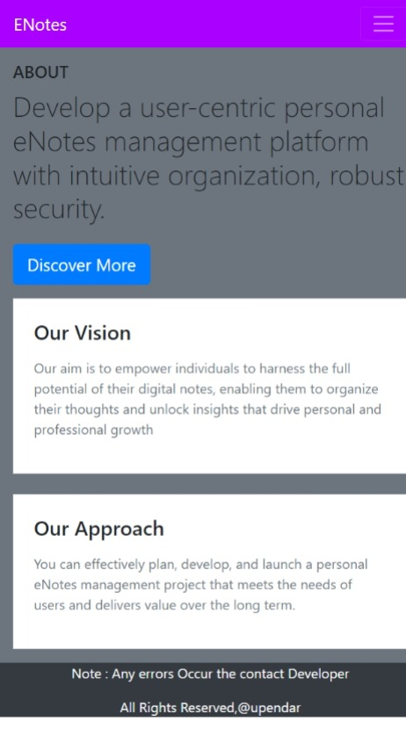

Slide 13

Target audience
Developers: Software developers, engineers, and coders looking for an efficient note management tool.
Students: College and university students seeking an organized platform for their study notes and research materials.
Professionals: Business professionals, researchers, and writers in need of a streamlined digital note-taking solution for their work.

Slide 14
Conclusion
In conclusion, the proposed Personal E-Notes Management Project provides a user-friendly, innovative solution for personal organization and productivity.
Focusing on security, privacy, and sustainability, it adapts to emerging technologies, revolutionizing digital note interaction.

Slide 15
References
www.youtube.com
www.stackoverflow.com
www.w3schools.com
www.javatpoint.com

Slide 16
Thank You….

